Slide 1

Cycle Cancelling
Algorithm in NetworkX
Mid-Project Presentation
Ofir kabiri
Valeria khotuliov
Supervised by jose yallouz

Slide 2
Project Overview
Implement and analyze the Cycle-Cancelling algorithm to solve the Min-Cost Max-Flow (MCMF) problem in directed graphs.
  Cycle cancelling algorithm for general networks.
Evaluate performance on various graph sizes and cost structures.
Analyze convergence, detection of negative-cost cycles and optimalty (MCMF).
Merge our contributions to the NetworkX main repository

Slide 3
Why Do We Care About MCMF?
Wireless networks can be modeled as connected graphs
We want to Maximizes Data Throughput (Max Flow)
  Ensure the entire network capacity is utilized
  Guarantees the highest possible total data transfer rate
Optimizes Financial Cost (Min Cost)
  diverting the maximum flow volume onto the cheapest leased connections and peering links

Slide 4

Why Do We Care About MCMF?

Slide 5
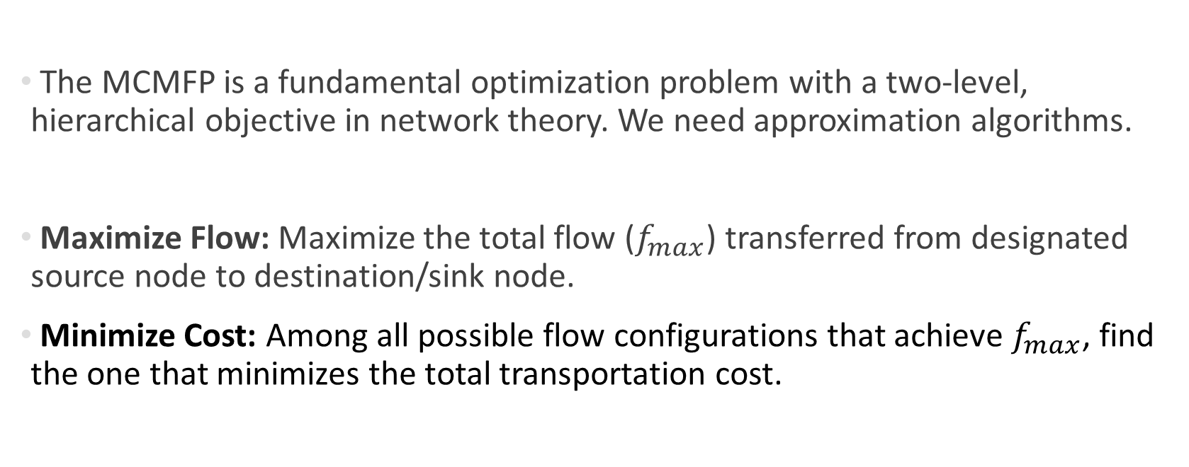
Min Cost Max Flow Problem
The MCMFP is a fundamental optimization problem with a two-level, hierarchical objective in network theory. We need approximation algorithms.
Maximize Flow: Maximize the total flow ($f_{max}$) transferred from designated source node to destination/sink node.
Minimize Cost: Among all possible flow configurations that achieve $f_{max}$, find the one that minimizes the total transportation cost.

Slide 6
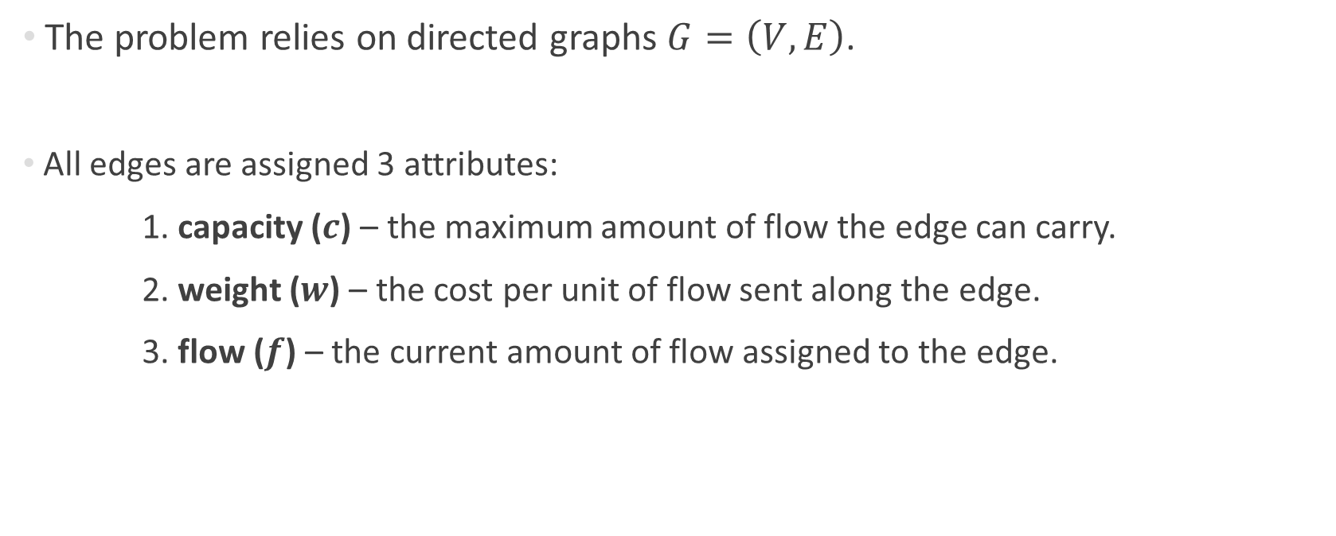
Network Model
The problem relies on directed graphs $G=\left(V,E\right)$.
All edges are assigned 3 attributes:
1. capacity ($c$) – the maximum amount of flow the edge can carry.
2. weight ($w$) – the cost per unit of flow sent along the edge.
3. flow ($f$) – the current amount of flow assigned to the edge.

Slide 7
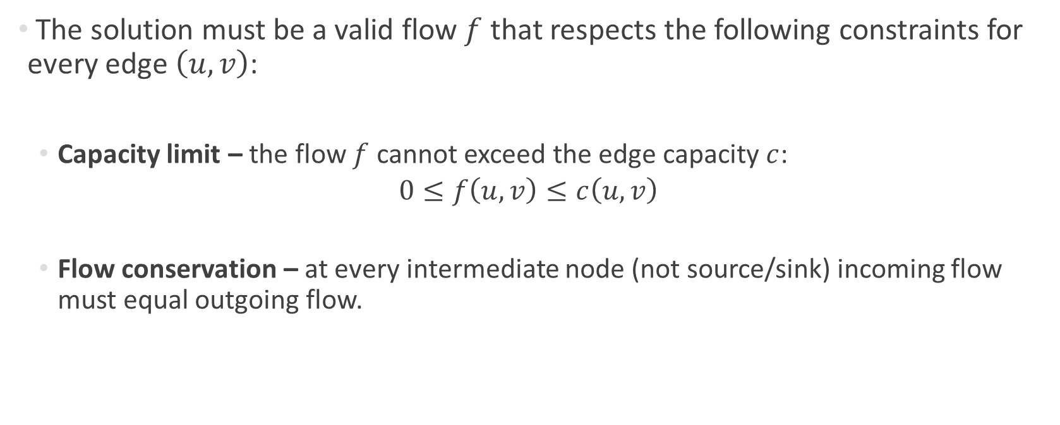
Network Model
The solution must be a valid flow $f$ that respects the following constraints for every edge $\left(u,v\right)$:
  Capacity limit – the flow $f$ cannot exceed the edge capacity $c$:
  $$0≤f\left(u,v\right)≤c\left(u,v\right)$$
  Flow conservation – at every intermediate node (not source/sink) incoming flow must equal outgoing flow.
Notes:
להוסיף שקף על הבעיה הלינארית, מה קיים ומה משתפר

Slide 8

The Goal
Find a feasible flow that meets all constraints with the minimum total cost:
$$\sum_{\left(u,v\right)∈E}{f\left(u,v\right)∙w\left(u,v\right)}$$

Slide 9
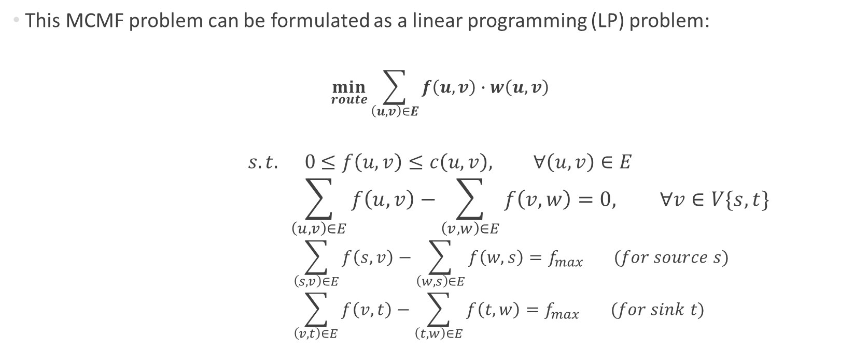
Problem Formulation
This MCMF problem can be formulated as a linear programming (LP) problem:
$$\min_{route}{\sum_{\left(u,v\right)∈E}{f\left(u,v\right)∙w\left(u,v\right)}}$$
$$s.t. 0≤f\left(u,v\right)≤c\left(u,v\right), ∀\left(u,v\right)∈E$$
$$\sum_{\left(u,v\right)∈E}{f\left(u,v\right)}−\sum_{\left(v,w\right)∈E}{f\left(v,w\right)}=0, ∀v∈V\{s,t\}$$
$$\sum_{\left(s,v\right)∈E}{f\left(s,v\right)}−\sum_{\left(w,s\right)∈E}{f\left(w,s\right)}=f_{max} (for source s)$$
$$\sum_{\left(v,t\right)∈E}{f\left(v,t\right)}−\sum_{\left(t,w\right)∈E}{f\left(t,w\right)}=f_{max} (for sink t)$$

Slide 10
Problem Formulation
Algorithms that solve this MCMF LP:
  Simplex, Successive Shortest Path, Cost Scaling, Cycle Cancelling.
Why we chose Cycle Cancelling:
  Directly derived from LP optimality conditions
  Works from any feasible maximum flow
  Lack of implementation in the NetworkX library

Slide 11
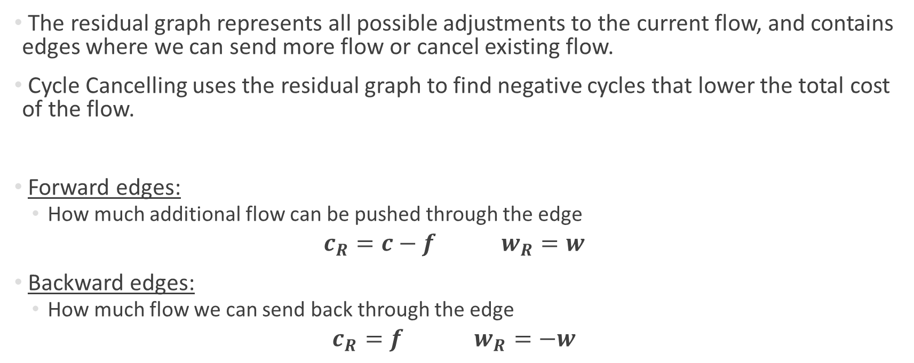
Residual Graph
The residual graph represents all possible adjustments to the current flow, and contains edges where we can send more flow or cancel existing flow.
Cycle Cancelling uses the residual graph to find negative cycles that lower the total cost of the flow.
Forward edges:
  How much additional flow can be pushed through the edge
$$c_{R}=c−f w_{R}=w$$
Backward edges:
  How much flow we can send back through the edge
$$c_{R}=f w_{R}=−w$$

Slide 12
Cycle Cancelling Algorithm
Overview
The principle:
A feasible flow has minimum cost if, and only if,
its residual graph contains no negative-cost cycles
Construct a residual network and iteratively identify and eliminate negative-cost cycles (reducing total cost) until no such cycles remain, guaranteeing optimality

Slide 13
Cycle Cancelling Algorithm
Overview
Step 1: Choose source and sink, and initialize maximum flow
The algorithm optimizes the cost of the flow, not the amount of flow.
We must start with a feasible flow that already achieves the maximum possible value (regardless of the cost).
Note: use a suitable algorithm to determine and assign the max flow.

Slide 14
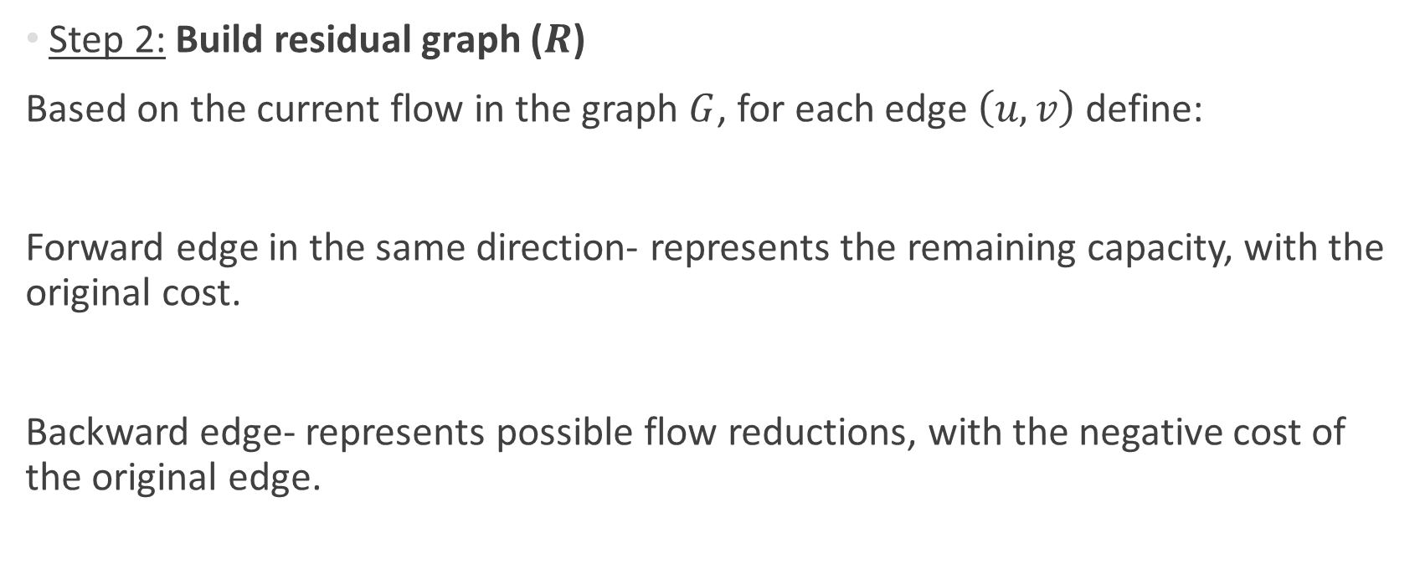
Cycle Cancelling Algorithm
Overview
Step 2: Build residual graph ($R$)
Based on the current flow in the graph $G$, for each edge $\left(u,v\right)$ define:
Forward edge in the same direction- represents the remaining capacity, with the original cost.
Backward edge- represents possible flow reductions, with the negative cost of the original edge.

Slide 15
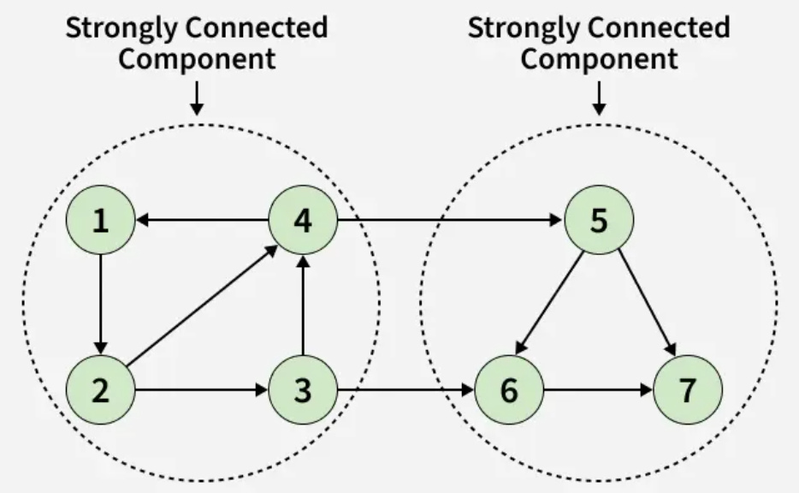
Cycle Cancelling Algorithm
Overview
Iterative main loop
Step 3: Find all strongly connected components (SCC)
SCC definition:
For every pair of nodes A,B there is a
path from A to B and a path from B to A.

Slide 16
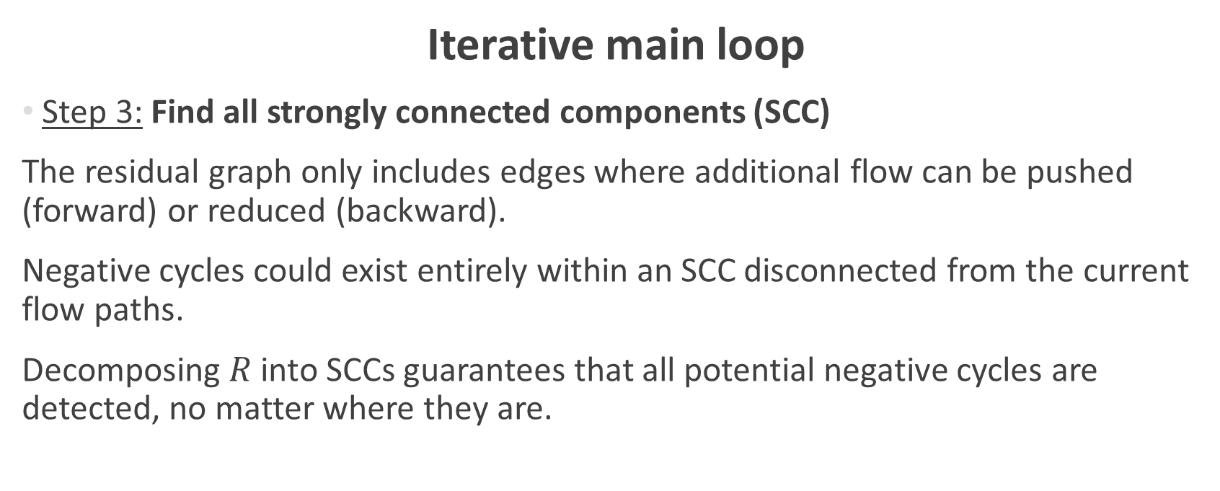
Cycle Cancelling Algorithm
Overview
Iterative main loop
Step 3: Find all strongly connected components (SCC)
The residual graph only includes edges where additional flow can be pushed (forward) or reduced (backward).
Negative cycles could exist entirely within an SCC disconnected from the current flow paths.
Decomposing $R$ into SCCs guarantees that all potential negative cycles are detected, no matter where they are.

Slide 17
Cycle Cancelling Algorithm
Overview
Iterative main loop
Step 4: Detect a negative cycle
A negative cycle indicates flow can be rerouted to reduce total cost.
Cycle Cancelling identifies cycles whose total residual cost is negative:
Sending flow around this cycle lowers overall cost without changing total flow.
Note: use a suitable algorithm to detect a negative cycle.

Slide 18
Cycle Cancelling Algorithm
Overview
Iterative main loop
Step 5: Augment flow along the negative cycle
Push flow around the negative cycle equal to the smallest residual capacity on the cycle (bottleneck).
This reduces the total cost while keeping total flow constant.
Adjust forward and backward edges in the residual graph accordingly.

Slide 19
Cycle Cancelling Algorithm
Overview
Step 6: Rebuild the residual graph and repeat iterative main loop
After rerouting flow, residual capacities change.
Set up for next iteration in the main loop.

Slide 20
Cycle Cancelling Algorithm
Overview
Termination:
Halt when the search for a negative cycle across the entire residual graph is exhausted.
When there are no negative cycles in all SCCs in the residual graph the algorithm concludes:
The current Maximum Flow is guaranteed to be the Minimum Cost Flow

Slide 21
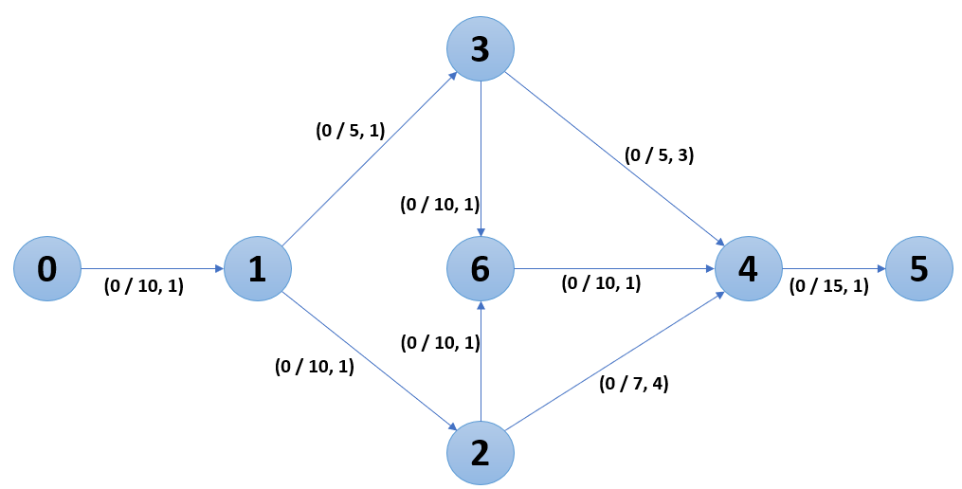
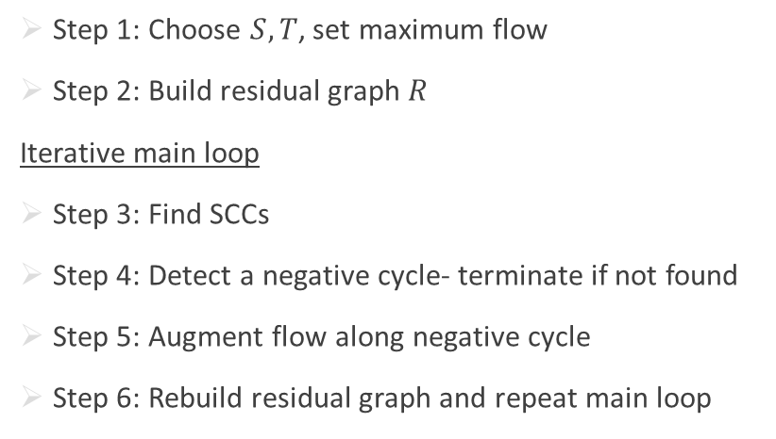
Cycle Cancelling Algorithm
Demonstration
Step 1: Choose $S,T$, set maximum flow
Step 2: Build residual graph $R$
Iterative main loop
Step 3: Find SCCs
Step 4: Detect a negative cycle- terminate if not found
Step 5: Augment flow along negative cycle
Step 6: Rebuild residual graph and repeat main loop

Slide 22
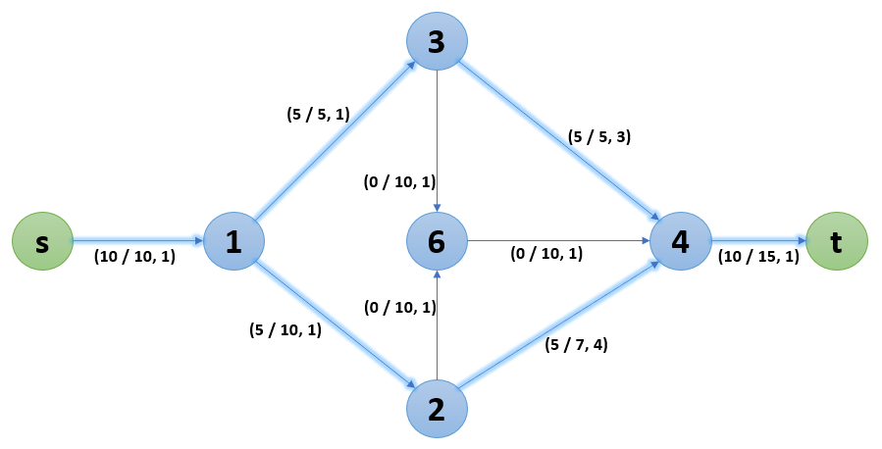
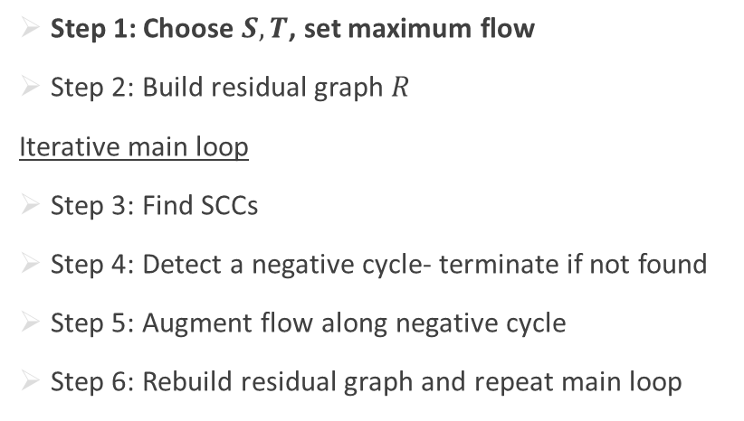
Cycle Cancelling Algorithm
Demonstration
Step 1: Choose $S,T$, set maximum flow
Step 2: Build residual graph $R$
Iterative main loop
Step 3: Find SCCs
Step 4: Detect a negative cycle- terminate if not found
Step 5: Augment flow along negative cycle
Step 6: Rebuild residual graph and repeat main loop

Slide 23
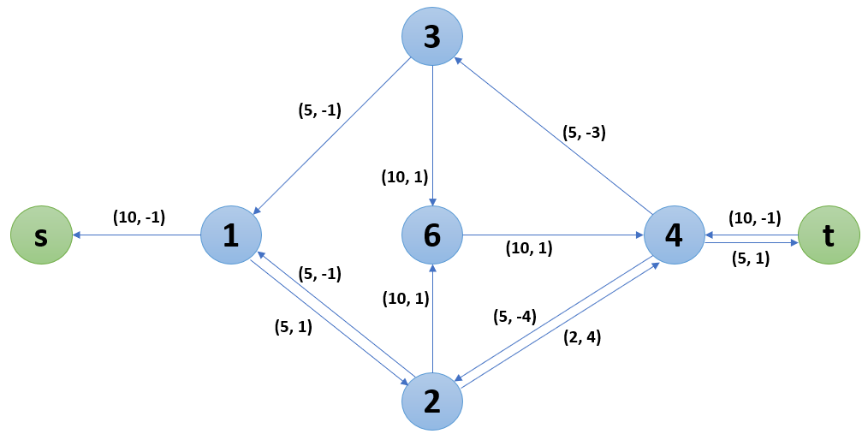
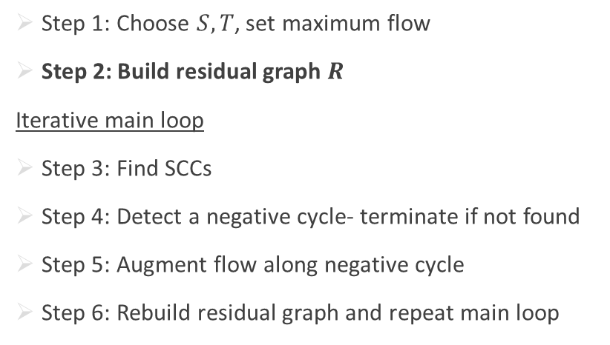
Cycle Cancelling Algorithm
Demonstration
Step 1: Choose $S,T$, set maximum flow
Step 2: Build residual graph $R$
Iterative main loop
Step 3: Find SCCs
Step 4: Detect a negative cycle- terminate if not found
Step 5: Augment flow along negative cycle
Step 6: Rebuild residual graph and repeat main loop

Slide 24
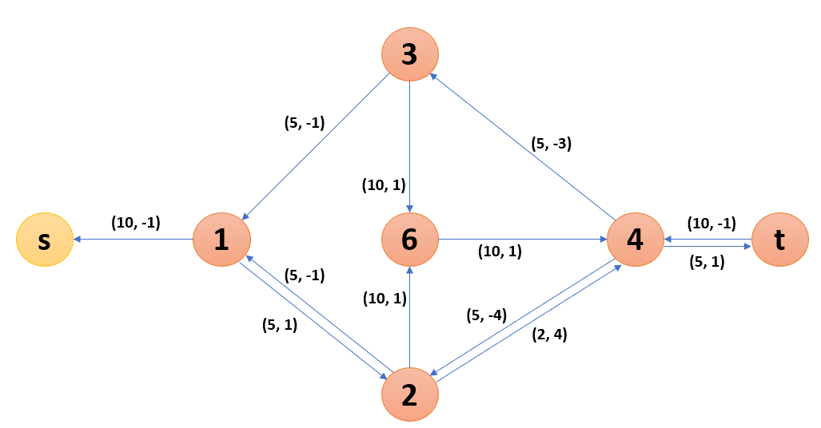
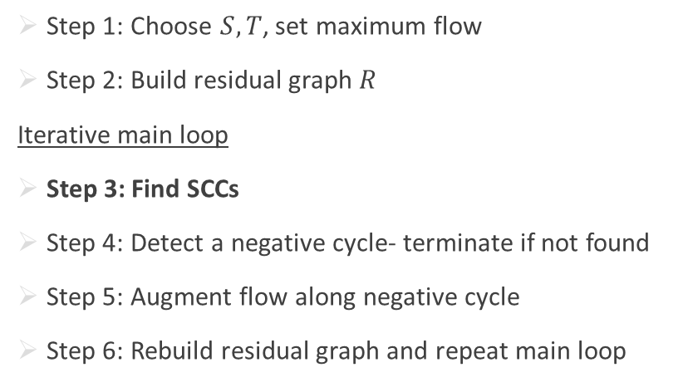
Cycle Cancelling Algorithm
Demonstration
Step 1: Choose $S,T$, set maximum flow
Step 2: Build residual graph $R$
Iterative main loop
Step 3: Find SCCs
Step 4: Detect a negative cycle- terminate if not found
Step 5: Augment flow along negative cycle
Step 6: Rebuild residual graph and repeat main loop

Slide 25
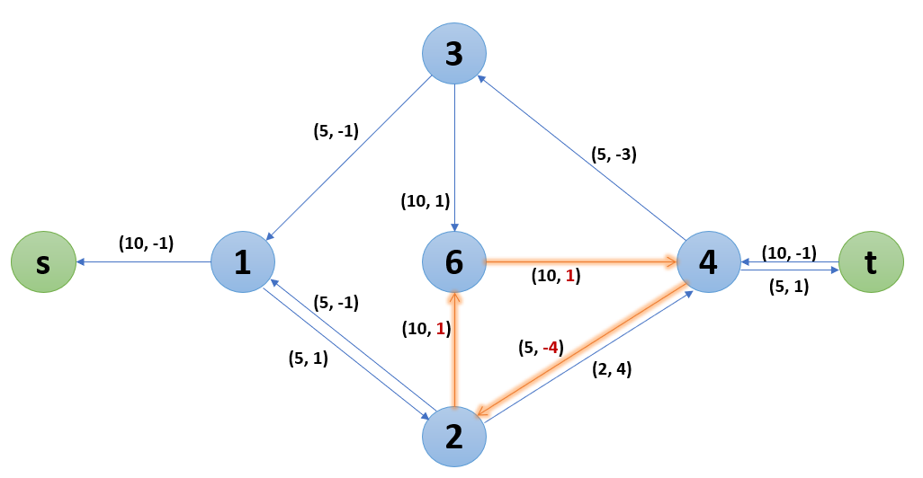

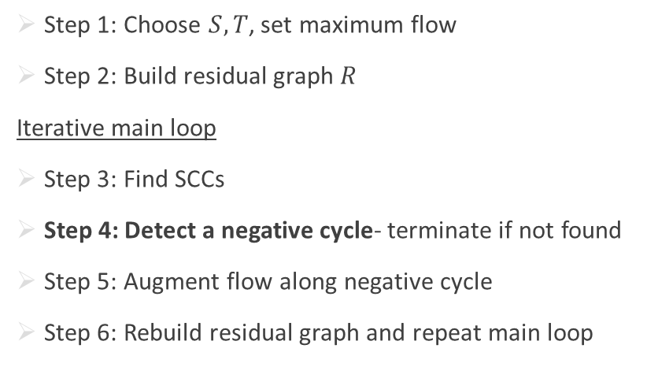
Cycle Cancelling Algorithm
Demonstration
Step 1: Choose $S,T$, set maximum flow
Step 2: Build residual graph $R$
Iterative main loop
Step 3: Find SCCs
Step 4: Detect a negative cycle- terminate if not found
Step 5: Augment flow along negative cycle
Step 6: Rebuild residual graph and repeat main loop
Bottleneck: 5 (4$→$2)

Slide 26
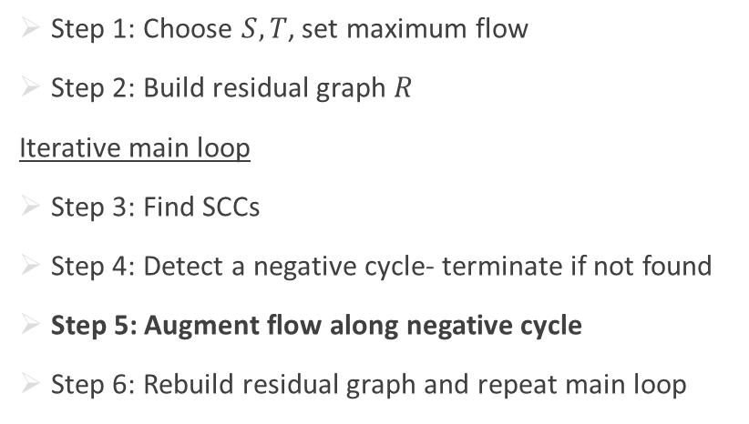
Cycle Cancelling Algorithm
Demonstration
Before:
Step 1: Choose $S,T$, set maximum flow
Step 2: Build residual graph $R$
Iterative main loop
Step 3: Find SCCs
Step 4: Detect a negative cycle- terminate if not found
Step 5: Augment flow along negative cycle
Step 6: Rebuild residual graph and repeat main loop

Slide 27
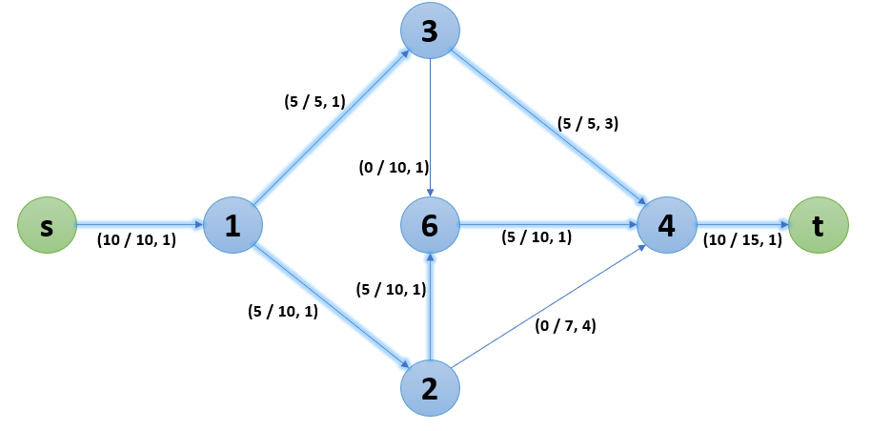
Cycle Cancelling Algorithm
Demonstration
After:
Step 1: Choose $S,T$, set maximum flow
Step 2: Build residual graph $R$
Iterative main loop
Step 3: Find SCCs
Step 4: Detect a negative cycle- terminate if not found
Step 5: Augment flow along negative cycle
Step 6: Rebuild residual graph and repeat main loop

Slide 28
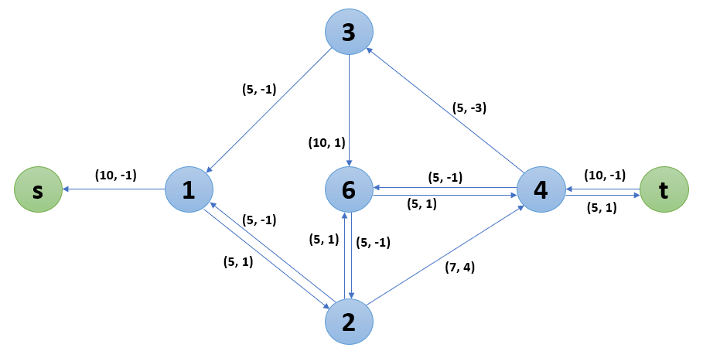
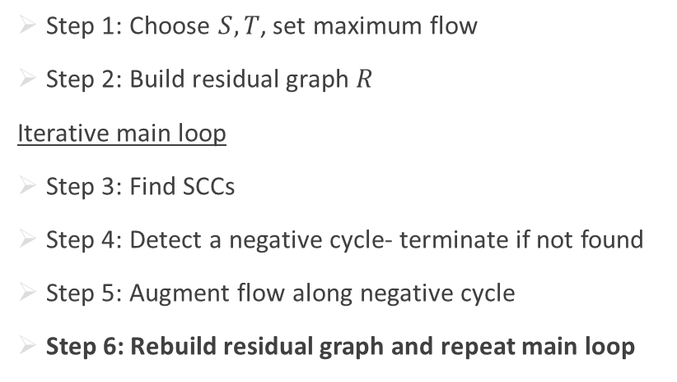
Cycle Cancelling Algorithm
Demonstration
New residual:
Step 1: Choose $S,T$, set maximum flow
Step 2: Build residual graph $R$
Iterative main loop
Step 3: Find SCCs
Step 4: Detect a negative cycle- terminate if not found
Step 5: Augment flow along negative cycle
Step 6: Rebuild residual graph and repeat main loop

Slide 29
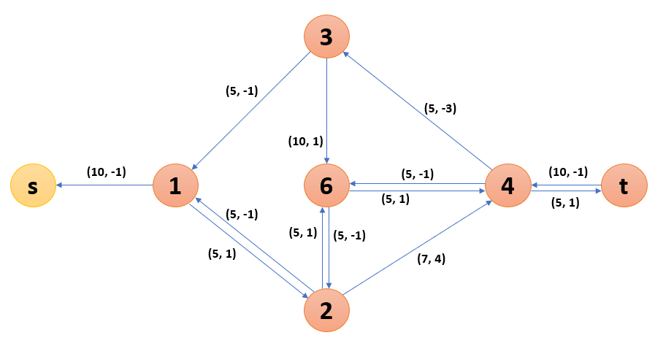
Cycle Cancelling Algorithm
Demonstration
Step 1: Choose $S,T$, set maximum flow
Step 2: Build residual graph $R$
Iterative main loop
Step 3: Find SCCs
Step 4: Detect a negative cycle- terminate if not found
Step 5: Augment flow along negative cycle
Step 6: Rebuild residual graph and repeat main loop

Slide 30
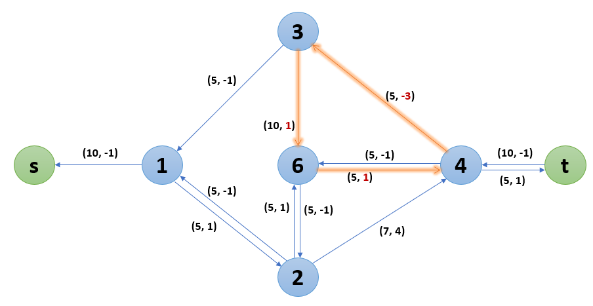

Cycle Cancelling Algorithm
Demonstration
Step 1: Choose $S,T$, set maximum flow
Step 2: Build residual graph $R$
Iterative main loop
Step 3: Find SCCs
Step 4: Detect a negative cycle- terminate if not found
Step 5: Augment flow along negative cycle
Step 6: Rebuild residual graph and repeat main loop
Bottleneck: 5 (4$→$3 or 6$→$4)

Slide 31
Cycle Cancelling Algorithm
Demonstration
Before:
Step 1: Choose $S,T$, set maximum flow
Step 2: Build residual graph $R$
Iterative main loop
Step 3: Find SCCs
Step 4: Detect a negative cycle- terminate if not found
Step 5: Augment flow along negative cycle
Step 6: Rebuild residual graph and repeat main loop

Slide 32
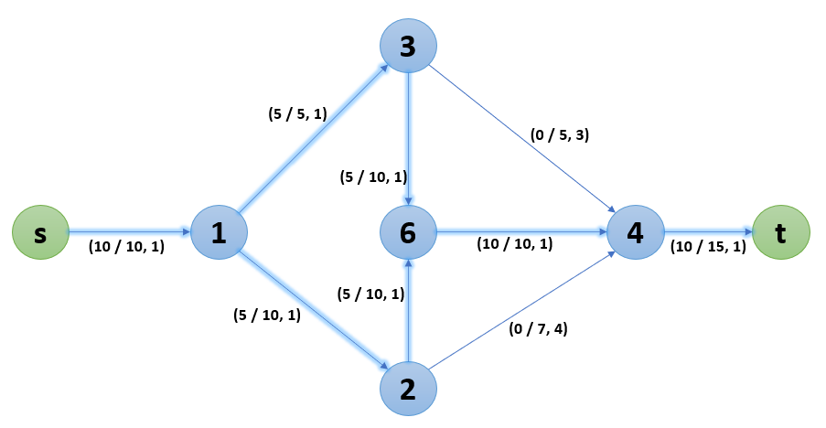
Cycle Cancelling Algorithm
Demonstration
After:
Step 1: Choose $S,T$, set maximum flow
Step 2: Build residual graph $R$
Iterative main loop
Step 3: Find SCCs
Step 4: Detect a negative cycle- terminate if not found
Step 5: Augment flow along negative cycle
Step 6: Rebuild residual graph and repeat main loop

Slide 33
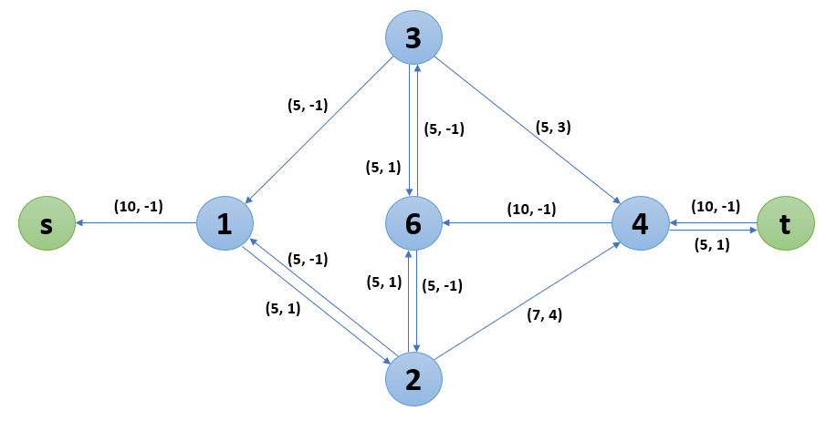
Cycle Cancelling Algorithm
Demonstration
Step 1: Choose $S,T$, set maximum flow
Step 2: Build residual graph $R$
Iterative main loop
Step 3: Find SCCs
Step 4: Detect a negative cycle- terminate if not found
Step 5: Augment flow along negative cycle
Step 6: Rebuild residual graph and repeat main loop

Slide 34
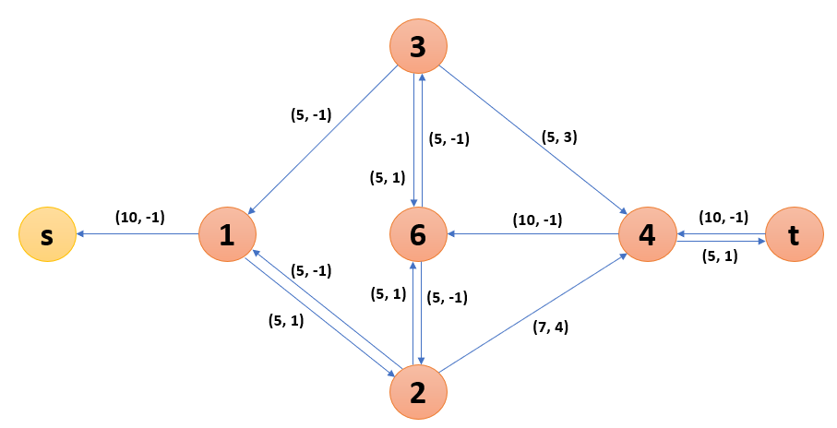
Cycle Cancelling Algorithm
Demonstration
Step 1: Choose $S,T$, set maximum flow
Step 2: Build residual graph $R$
Iterative main loop
Step 3: Find SCCs
Step 4: Detect a negative cycle- terminate if not found
Step 5: Augment flow along negative cycle
Step 6: Rebuild residual graph and repeat main loop

Slide 35
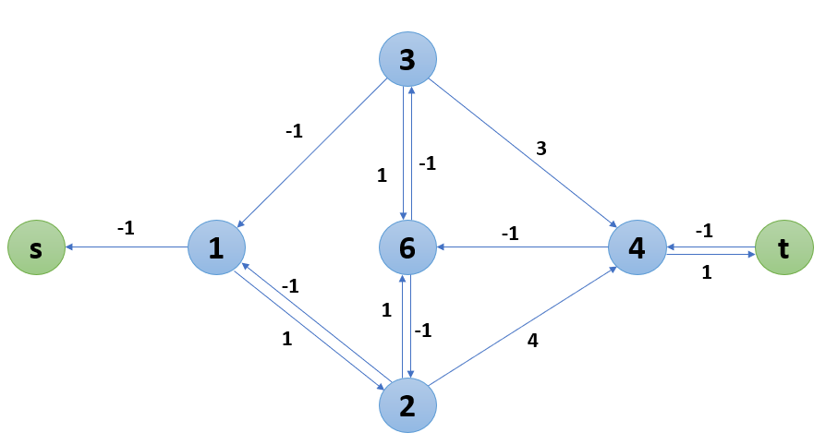

Cycle Cancelling Algorithm
Demonstration
Step 1: Choose $S,T$, set maximum flow
Step 2: Build residual graph $R$
Iterative main loop
Step 3: Find SCCs
Step 4: Detect a negative cycle- terminate if not found
Step 5: Augment flow along negative cycle
Step 6: Rebuild residual graph and repeat main loop

Slide 36

Cycle Cancelling Algorithm
Demonstration
The minimum cost path for the maximum flow
$$min cost=50$$

Slide 37
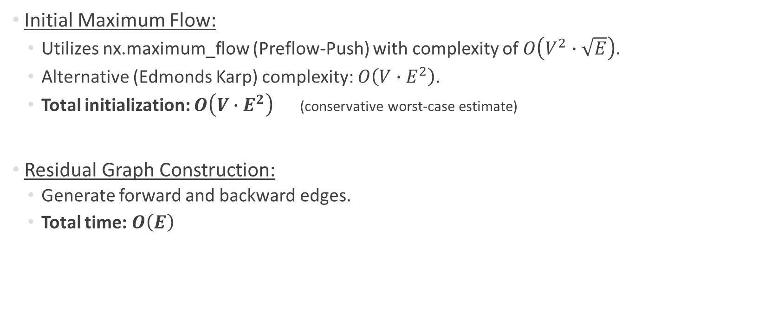
Algorithm Runtime
Initial Maximum Flow:
  Utilizes nx.maximum_flow (Preflow-Push) with complexity of $O\left(V^{2}∙\sqrt{E}\right)$.
  Alternative (Edmonds Karp) complexity: $O\left(V∙E^{2}\right)$.
  Total initialization: $O\left(V∙E^{2}\right)$ (conservative worst-case estimate)
Residual Graph Construction:
  Generate forward and backward edges.
  Total time: $O\left(E\right)$

Slide 38

Algorithm Runtime
Strongly Connected Components (SCC):
  BFS-based connectivity analysis.
  Total time: $O\left(V+E\right)$
Negative Cycle Detection:
  Dominated by the Bellman-Ford algorithm.
  Total time: $O\left(V∙E\right)$

Slide 39
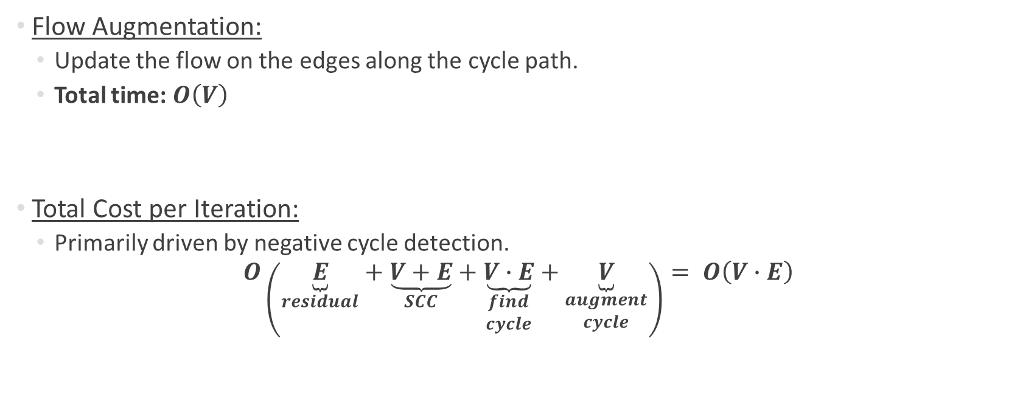
Algorithm Runtime
Flow Augmentation:
  Update the flow on the edges along the cycle path.
  Total time: $O\left(V\right)$
Total Cost per Iteration:
  Primarily driven by negative cycle detection.
$$O\left(\underset{residual}{\underbrace{E}}+\underset{SCC}{\underbrace{V+E}}+\underset{\begin{matrix}find \\ cycle\end{matrix}}{\underbrace{V∙E}}+\underset{\begin{matrix}augment \\ cycle\end{matrix}}{\underbrace{V}}\right)= O\left(V∙E\right)$$
Notes:
O של כל השלבים בסכום

Slide 40

Algorithm Runtime
Number Of Iterations (The Limiting Factor):
  The amount of augmentations is not strictly bounded by the graph size ($V,E$).
  The algorithm can perform a large number of iterations if capacity and weight values are high- each step only guarantees a minimum cost reduction of $1$ unit.

Slide 41
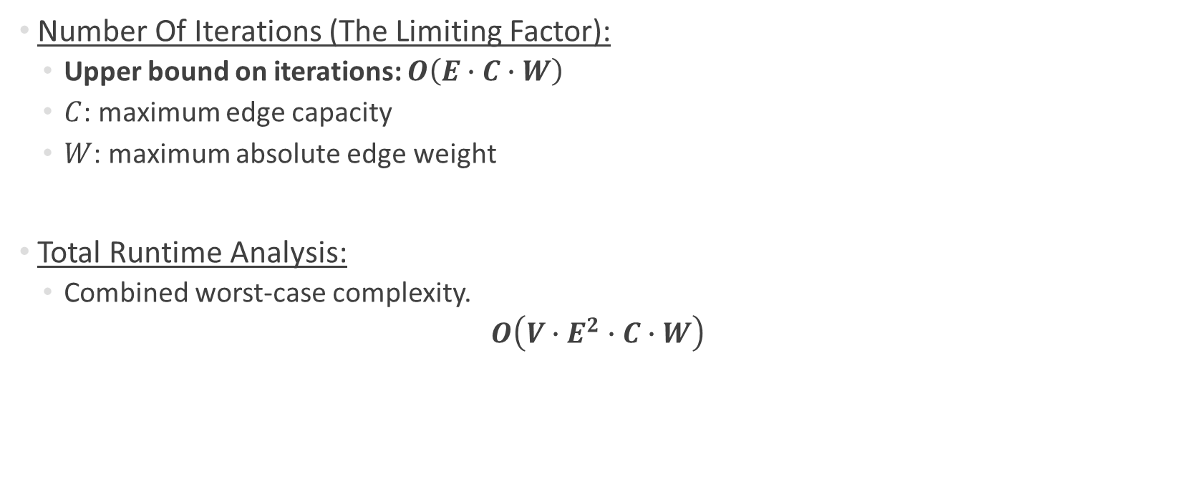
Algorithm Runtime
Number Of Iterations (The Limiting Factor):
  Upper bound on iterations: $O\left(E∙C∙W\right)$
  $C$: maximum edge capacity
  $W$: maximum absolute edge weight
Total Runtime Analysis:
  Combined worst-case complexity.
  $$O\left(V∙E^{2}∙C∙W\right)$$

Slide 42
Testing the Model

Slide 43
Testing Method
We first compared our results to the examples and solutions provided on:
https://algorithms.discrete.ma.tum.de/graph-algorithms/flow-cycle-cancelling/index_en.html
Website hosted by the Technical University of Munich (TUM)
  Provides interactive graph algorithm demonstrations.
  Includes step-by-step examples and solutions for the Cycle Cancelling algorithm.
  This allowed us to validate that our implementation produces correct flows and costs on known examples.

Slide 44
Testing Method
After initial verification, we compared our results against NetworkX’s built-in Min-Cost Flow algorithm.
We specifically checked:
  Maximum flow value
  Final flow dictionary (distribution of flow on edges)
  Total minimum cost achieved
This ensured accuracy and consistency of our implementation against a reliable, widely used library.

Slide 45
Testing Method
Test the algorithms of various graph types:
Diverse Topologies:
Used NetworkX random graph generation to ensure unbiased testing environments.
Density Scaling:
Varied edge density percentages to verify stability in both sparse and dense configurations.

Slide 46
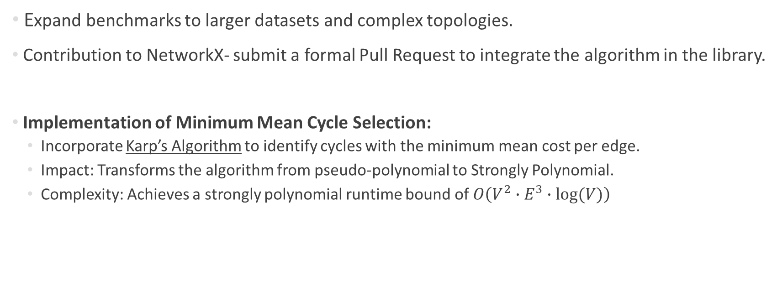
Next Steps
Expand benchmarks to larger datasets and complex topologies.
Contribution to NetworkX- submit a formal Pull Request to integrate the algorithm in the library.
Implementation of Minimum Mean Cycle Selection:
  Incorporate Karp’s Algorithm to identify cycles with the minimum mean cost per edge.
  Impact: Transforms the algorithm from pseudo-polynomial to Strongly Polynomial.
  Complexity: Achieves a strongly polynomial runtime bound of $O\left(V^{2}∙E^{3}∙log⁡(V)\right)$

Slide 47

Any Questions??
Thank you for your time

